Slide 1
Capstone Project ISA Review #2
(Final application procedure)
Classical Monte Carlo analysis
(Markov chain Monte Carlo simulations)
Project Title : Quantum Monte Carlo Algorithm
Project Guide : Dr. Gajanan Honnavar
Project Team : Danush Vikraman PES2UG22EC049
Hannah abagail PES2UG22EC058
Prasanna kesavraj PES2UG22EC099

Slide 2
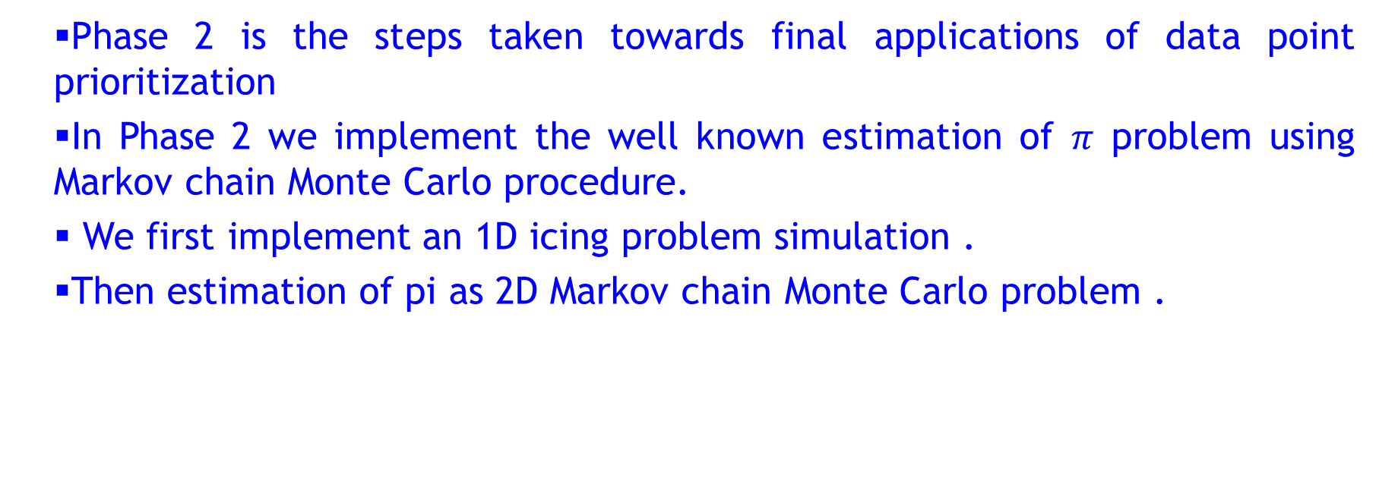
Phase 2-Steps taken towards final application procedure
Phase 2 is the steps taken towards final applications of data point prioritization
In Phase 2 we implement the well known estimation of $π$ problem using Markov chain Monte Carlo procedure.
We first implement an 1D icing problem simulation .
Then estimation of pi as 2D Markov chain Monte Carlo problem .

Slide 3
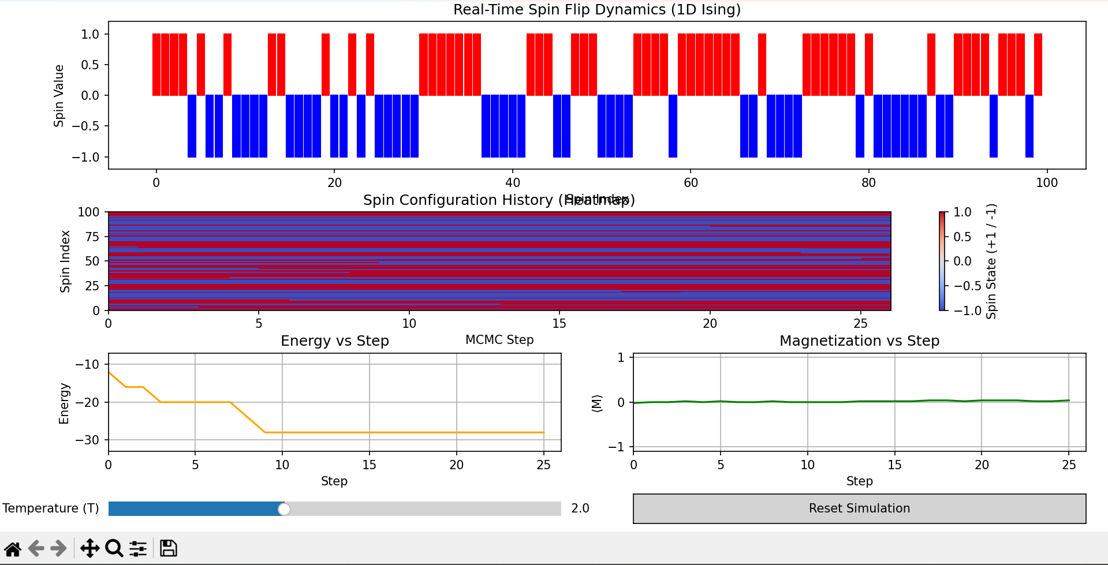
1D icing model simulation
.

Slide 4
Limitations of MCMC Algorithm
Higher error rates as samples are not inherently Independent
Solution
We discard the first n samples which in tis case have high error rates . This is called burn in period

Slide 5
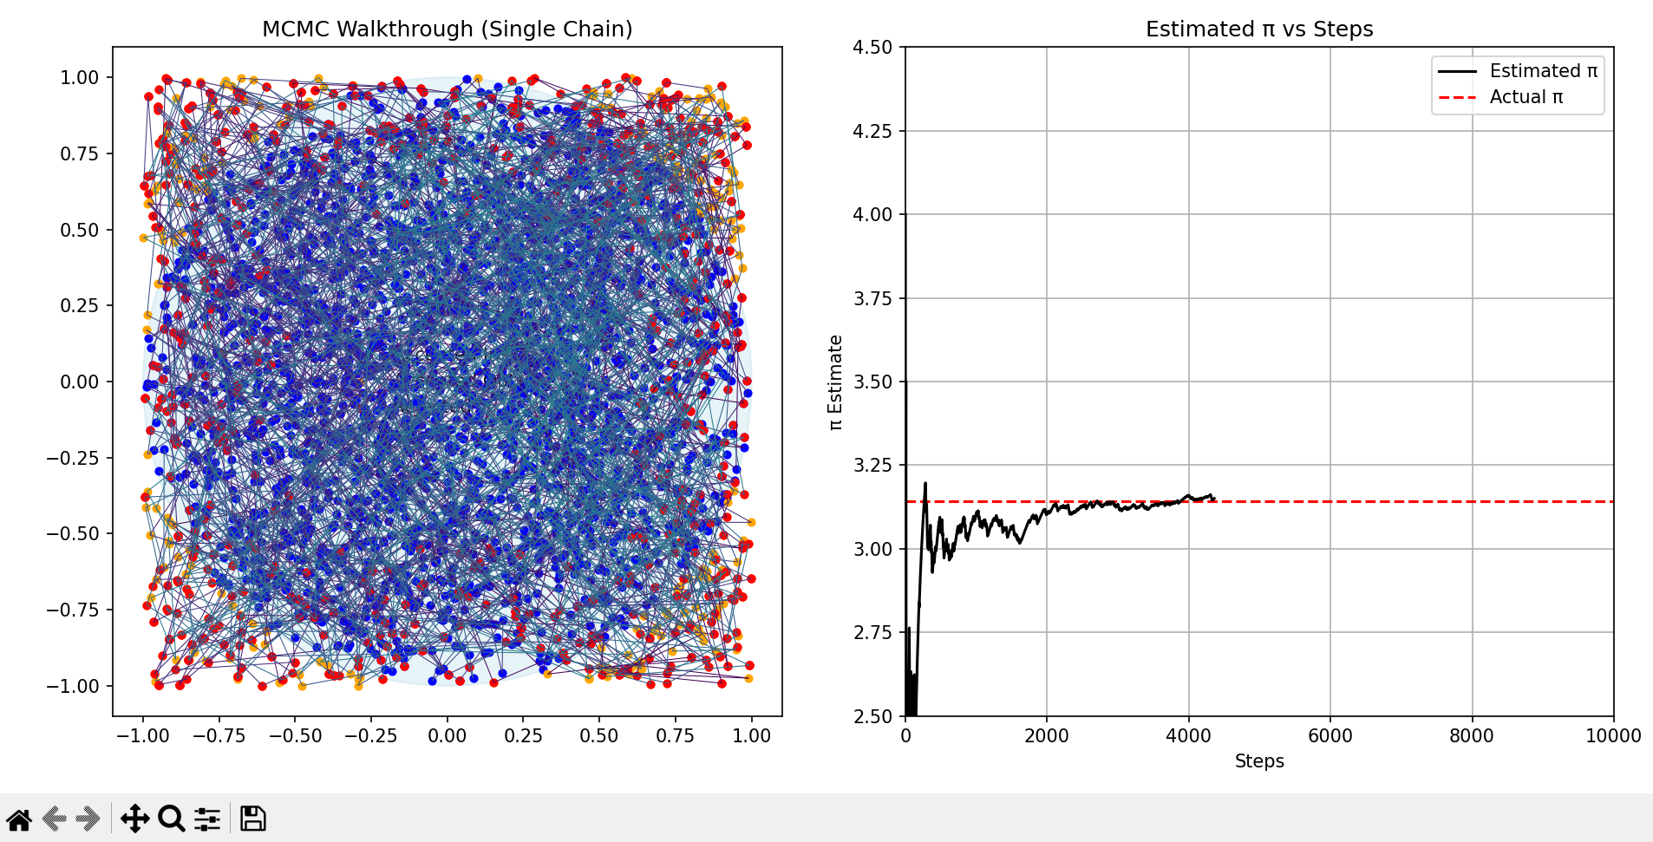
Final Estimated π (post burn-in): 3.136000
π Estimation Error: 0.005593
Time Taken: 0.08 seconds
Percentage error: 0.18%

Slide 6
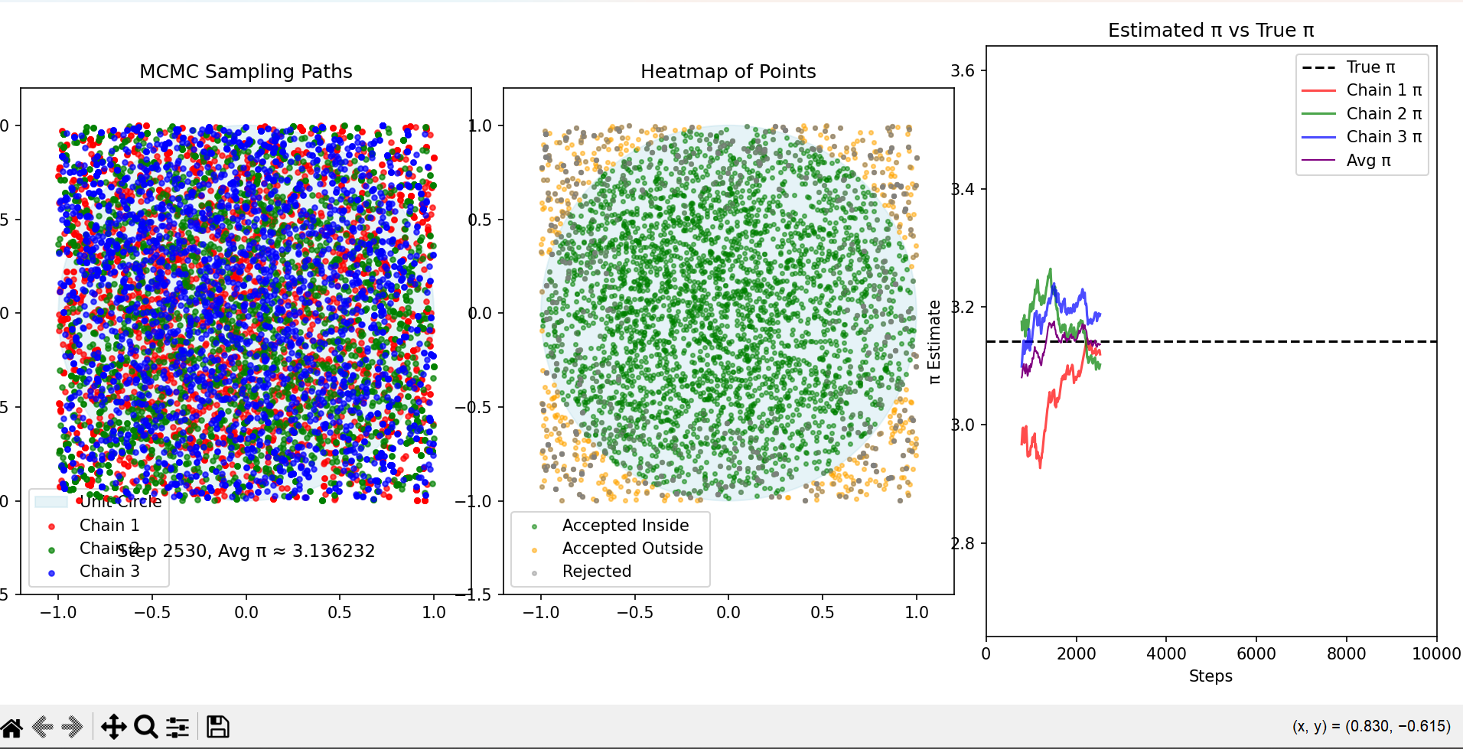
Methods to improve the accuracy of MCMC
We can use multiple markov chains with a burn in period and the final result is an average of the multiple chains
Chain 1 π estimate: 3.177333 | Error: 0.035741 (True π: 3.141593)
Chain 2 π estimate: 3.120000 | Error: 0.021593 (True π: 3.141593)
Chain 3 π estimate: 3.136889 | Error: 0.004704 (True π: 3.141593)
Final Average Estimated π over 3 chains: 3.144741 Total computation time: 0.19 seconds Absolute Error of Average π: 0.003148
Percentage Error of Average π: 0.1002%

Slide 7
Summary of Phase 2
In conclusion to phase 2 the key points are :
To proceed towards Data point prioritization problem we modify the classical Monte Carlo with Markov chains fitted with burn in error correction
This vastly improves time complexity and also improves the error %

Slide 8
Future execution plans
The next phase of our project involves 3 Approaches
1)We solve pure 3D lattice using Quantum MCMC
2)We convert the 3D lattice into N 2d lattices solve them via Classical MCMC and integrate the results via Quantum computing
3)We make a comparison between the 2 and give comprehensive analysis
4)We will have an algorithm that is able to process data points and prioritize them with lower error rates

Slide 9
Thank You

